Slide 1
TESTING & MODELING USERS by 19sw125

Slide 2


USER TESTING & USABILITY TESTING
User testing is the process through which the interface and functions of a website, app, product, or service are tested by real users who perform specific tasks in realistic conditions
Usability testing refers to evaluating a product or service by testing it with representative users.
The goal is to identify any usability problems, collect qualitative and quantitative data and determine the participant's satisfaction with the product.

Slide 3
WHY USER TESTING IS IMPORTANT?
To check if product meet user’s expectations
Matches business decisions to real-world use
Removes flaws in the product
Allows you to see how successful users are with their tasks
Useful for getting user reactions and feedback about the product
WHY USABILITY TESTING IS IMPORTANT?
usability is important because it can make the users complete the task accurately, and users can operate it with a pleasant mood rather than feeling stupid

Slide 4


Slide 5
USER MODELING
User modeling is the subdivision of human–computer interaction which describes the process of building up and modifying a conceptual understanding of the user. The main goal of user modeling is customization and adaptation of systems to the user's specific needs

Slide 6
GOMS MODEL
Goals, operators, methods, and selection rules is a method derived from human-computer interaction (HCI) and constructs a description of human performance
The goal is what the user wants to accomplish.
The operator is what the user does to accomplish the goal.
The method is a series of operators that are used to accomplish the goal.
Selection rules are used if there are multiple methods, to determine how one was selected over the others.

Slide 7
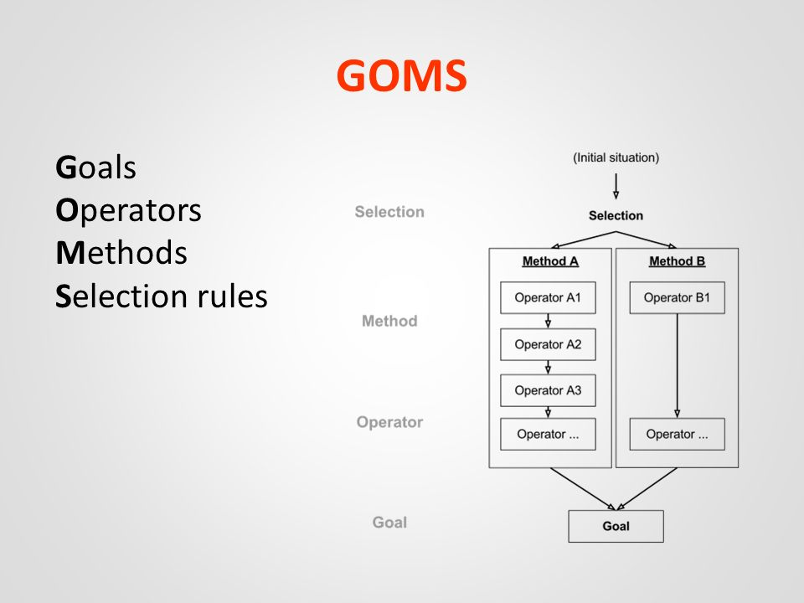

Slide 8
USES OF GOMS MODEL
When analyzing existing designs
to describe how a user completes a task.
Allows analysts to estimate performance times and predict how the users will learn

Slide 9
FITTS'S LAW
Fitts's Law provides a model of human movement, established in 1954 by Paul Fitts, which can accurately predict the amount of time taken to move to and select a target.
Fitts' Law states: " ...the time to acquire a target is a function of the distance to and size of the target"
As the distance increases, movement takes longer and as the size decreases selection again takes longer.
Although originally developed according to movement in the physical world,
In human-computer interaction Fitts's Law is typically applied to movement through the graphical user interface using a cursor or other type of pointer.

Slide 10
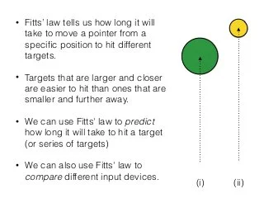

Slide 11
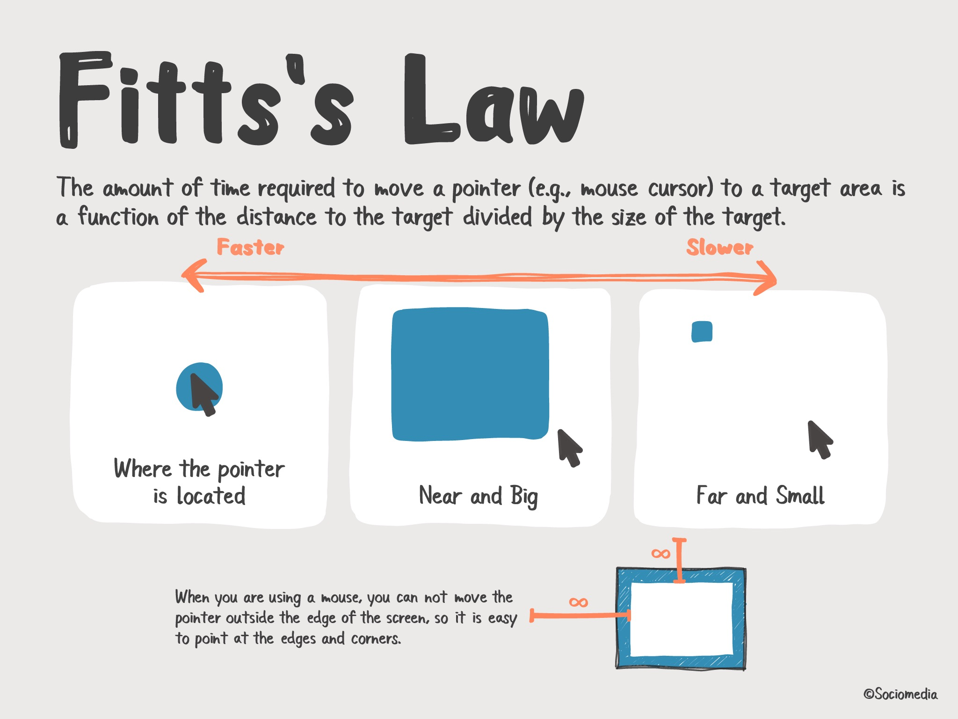

Slide 12


